Slide 1
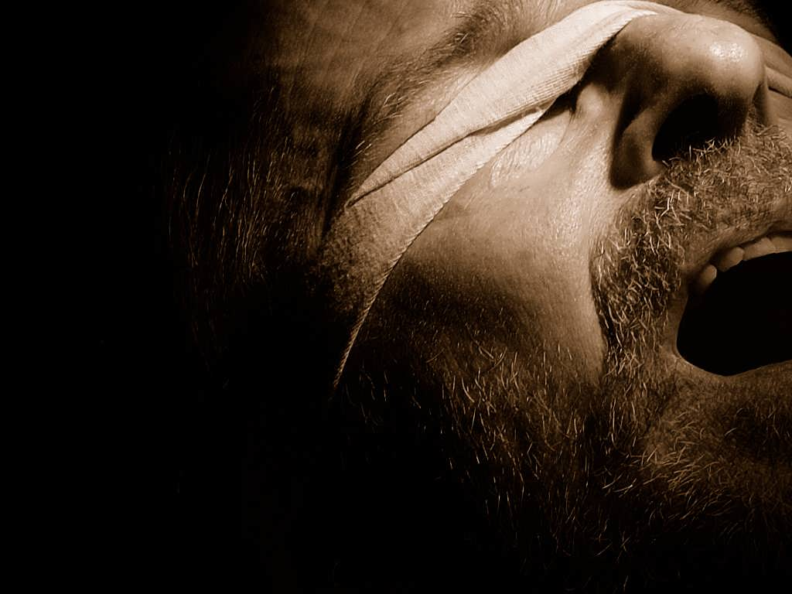


the bondage of
Cults and Isms
the
Word of Faith
Movement
A free CD of this message will be available following the service
It will also be available for podcast later this week at calvaryokc.com

Slide 2
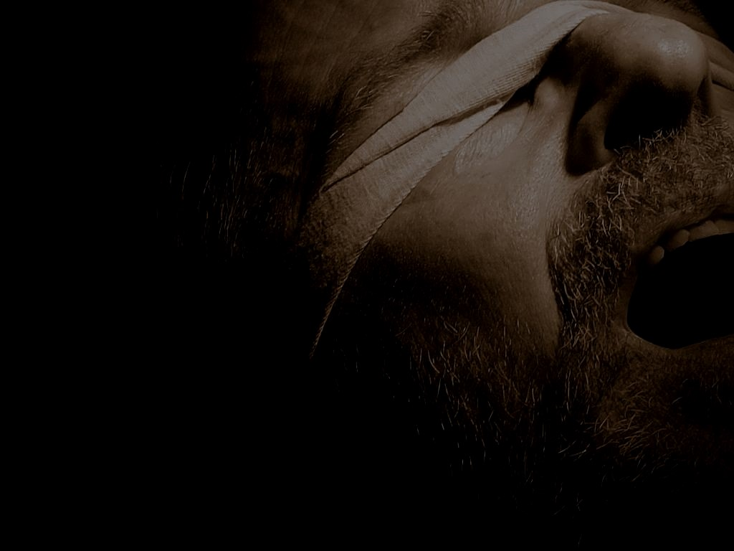
Word of Faith Movement
Word-Faith
Positive Confession
Profess It and Possess It
Health and Wealth Doctrine
Name It and Claim It
Blab It and grab It
Positive Lying (Chuck Smith Jr.)
the bondage of Word of Faith
the

Slide 3
the bondage of Word of Faith
the

Slide 4
Rom. 10.8 ~ But what does it say? “The word is near you, in your mouth and in your heart" (that is, the word of faith which we preach)
the bondage of Word of Faith
the

Slide 5
the bondage of Word of Faith
the

Slide 6
Logos ~ the written Word
Rhēma ~ the spoken Word
the bondage of Word of Faith
the

Slide 7
Rom. 10.17 ~ (as it is written, “I have made you a father of many nations") in the presence of Him whom he believed — God, who gives life to the dead and calls those things which do not exist as though they did;
the bondage of Word of Faith
the

Slide 8
Prov. 6.1 ~ My son, if you become surety for your friend,
If you have shaken hands in pledge for a stranger,
Prov. 6.2 ~ You are snared by the words of your mouth;
You are taken by the words of your mouth.
the bondage of Word of Faith
the

Slide 9
Prov. 18.21 ~ Death and life are in the power of the tongue,
And those who love it will eat its fruit.
the bondage of Word of Faith
the

Slide 10
the bondage of Word of Faith
the

Slide 11
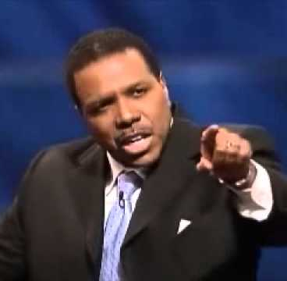
Mark 11.22 ~ So Jesus answered and said to them, “Have faith in God.”
objective genitive case
genitive case
Theos ~
“Have the faith of God.”
God is the object of the faith
“Have God-like faith.”
Literally, (Wuest) And answering, Jesus says to them, “Be constantly having faith in God.”
Creflo Dollar ~ “In the beginning, God spoke faith-filled words and saw them come to pass.”
the bondage of Word of Faith
the

Slide 12
the bondage of Word of Faith
the

Slide 13
Faith ~ n. pistis; v. piteuō (usually translated believe)
To put faith in, rely on, have confidence in
Synonyms ~ faith, believe, trust
No, have faith (trust) in God
Have faith in faith?
the bondage of Word of Faith
the

Slide 14
the bondage of Word of Faith
the

Slide 15
Matt. 8.16-17 ~ ¹⁶ When evening had come, they brought to Him many who were demon-possessed. ¹⁷ And He cast out the spirits with a word, and healed all who were sick, that it might be fulfilled which was spoken by Isaiah the prophet, saying:
“He Himself took our infirmities
And bore our sicknesses.” (Is. 53.4)
the bondage of Word of Faith
the

Slide 16
Heb. 2:8-9a (NASB) ~ ⁸ You have put all things in subjection under his feet."
For in subjecting all things to him, He left nothing that is not subject to him. But now we do not yet see all things subjected to him.
⁹ But we do see Him who was made for a little while lower than the angels, namely, Jesus,
the bondage of Word of Faith
the

Slide 17
the bondage of Word of Faith
the

Slide 18
3 John 2 ~ Beloved, I pray that you may prosper in all things and be in health, just as your soul prospers.
the bondage of Word of Faith
the

Slide 19
the bondage of Word of Faith
the

Slide 20
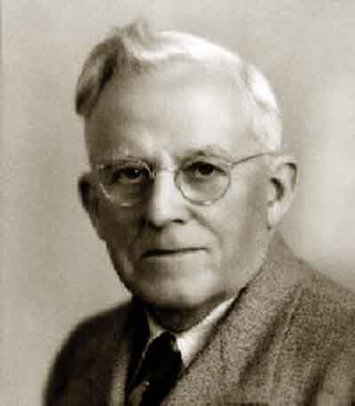
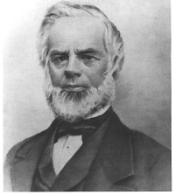
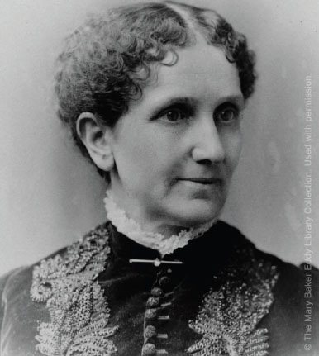
Influenced by Phineas P. Quimby (New Thought) and Mary
Baker Eddy (Christian
Science)
E. W. Kenyon
(1867-1948)
the bondage of Word of Faith
the

Slide 21
the bondage of Word of Faith
the

Slide 22
Kenoticism
Phil. 2:5-7 (NASB) ~ ⁵ Have this attitude in yourselves which was also in Christ Jesus, ⁶ who, although He existed in the form of God, did not regard equality with God a thing to be grasped, ⁷ but emptied Himself, taking the form of a bond- servant, and being made in the likeness of men.
Emptied ~ kenoō
the bondage of Word of Faith
the

Slide 23
the bondage of Word of Faith
the

Slide 24
Kenneth Copeland ~ “The Spirit of God spoke to me and He said, ‘Son, realize this.’ Now follow me in this and don't let your tradition trip you up. He said, ‘Think this way - a twice-born man whipped Satan in his own domain.'
“And I threw my Bible down ... like that. I said, ‘What?'
“He said, ‘A born-again man defeated Satan. The firstborn of many brethren defeated him.' He said, ‘You are the very image;
the bondage of Word of Faith
the

Slide 25
the very copy of that one.'
“I said, ‘Goodness, gracious sakes alive!' And I began to see what had gone on in there, and I said, ‘Well now, You don't mean, You couldn't dare mean, that I could have done the same thing?'
“He said, ‘Oh yeah, if you'd had the knowledge of the Word of God that He did, you could have done the same thing, ‘cause you're a reborn man too.’"
the bondage of Word of Faith
the

Slide 26
Creflo Dollar ~ “If Jesus came as God, then why did God have to anoint him? If Jesus – See, God’s already anointed … Jesus came as a man, that’s why it was legal to anoint Him. God doesn’t need anointing. He is anointing. Jesus came as a man and at age thirty, God is now getting ready to demonstrate to us and give us an example of what a man with the anointing can do … Jesus didn’t come as God, He came as a man, and He did not come perfect.
the bondage of Word of Faith
the

Slide 27
“And somebody said, ‘Well, Jesus came as God.’ Well, how many of you know the Bible says God never sleeps nor slumbers and yet in the book of Mark we see Jesus asleep in the back of the boat? Y'all please listen to me, please listen to me; this ain’t no heresy. I’m not some false prophet. I’m just readin’ this out to you from the Bible. I’m just telling you all these fantasy preachers have been preachin’ all of this stuff for all of these years and we bought the package.”
the bondage of Word of Faith
the

Slide 28
the bondage of Word of Faith
the

Slide 29
1 Pet. 3:18-19 ~ ¹⁸ For Christ also suffered once for sins, the just for the unjust, that He might bring us to God, being put to death in the flesh but made alive by the Spirit, ¹⁹ by whom also He went and preached to the spirits in prison …
the bondage of Word of Faith
the

Slide 30
Eph. 4:8-9 ~ ⁸ Therefore He says:
“When He ascended on high,
He led captivity captive,
And gave gifts to men."
⁹ Now this, “He ascended" — what does it mean but that He also first descended into the lower parts of the earth?
the bondage of Word of Faith
the

Slide 31
The Apostles’ Creed
I believe in God the Father Almighty,
Maker of heaven and earth:
And in Jesus Christ his only Son our Lord,
Who was conceived by the Holy Ghost,
Born of the Virgin Mary,
Suffered under Pontius Pilate,
Was crucified, dead, and buried:
He descended into hell;
The third day he rose again from the dead;
He ascended into heaven …
the bondage of Word of Faith
the

Slide 32
the bondage of Word of Faith
the

Slide 33
Eph. 2:1-2 ~ ¹ And you He made alive, who were dead in trespasses and sins, ² in which you once walked according to the course of this world, according to the prince of the power of the air, the spirit who now works in the sons of disobedience,
the bondage of Word of Faith
the

Slide 34
2 Cor. 4:3-4 ~ ³ But even if our gospel is veiled, it is veiled to those who are perishing, ⁴ whose minds the god of this age has blinded, who do not believe, lest the light of the gospel of the glory of Christ, who is the image of God, should shine on them.
the bondage of Word of Faith
the

Slide 35
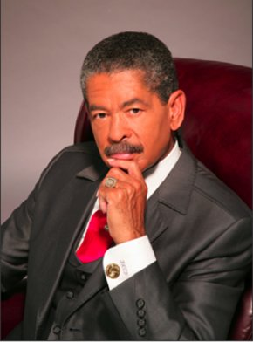
“Do you think that the punishment for our sin was to die on a
cross? If that were the
case, the two thieves
could have paid your price.
No, the punishment was to
go into hell itself and to
serve time in hell
separated from God.”
Fred Price
the bondage of Word of Faith
the

Slide 36
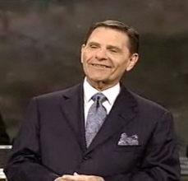
“He [Jesus] is suffering all that there is to suffer. There is no
suffering left apart from
Him. His emaciated,
poured out, little wormy
spirit is down in the
bottom of that thing
[hell]. And the Devil thinks he’s got Him destroyed.”
Kenneth Copeland
the bondage of Word of Faith
the

Slide 37
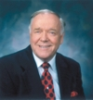
“He took upon Himself the nature of Satan.”
“Spiritual death means
something more than
separation from God.
Spiritual death also
means having Satan’s
Nature … Jesus tasted death–spiritual death–for every man.”
Kenneth Hagin
the bondage of Word of Faith
the

Slide 38
the bondage of Word of Faith
the

Slide 39
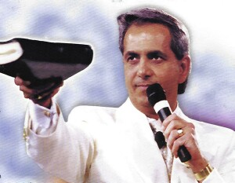
Claims to have a video of Jesus walking around in one of his
meetings
Godhead exists in 9
Persons
Women were originally
intended to give birth
from their sides
Benny Hinn
the bondage of Word of Faith
the

Slide 40
Benny Hinn~ “My, you know, whoosh! The Holy Ghost is just showing me some stuff, I'm getting dizzy! I'm telling you the truth - it's, it's just heavy right now on me … He's [referring to Jesus] in the underworld now. God isn't there, and the Bible says He was begotten. Do you know what the word begotten means? It means reborn. Do you want another shocker? Have you been begotten? So was He. Don't let anyone
the bondage of Word of Faith
the

Slide 41
deceive you. Jesus was reborn. You say, ‘What are you talking about?’ He was reborn, He had to be reborn … If He was not reborn, I could not be reborn. Jesus was born again … How can I face Jesus and say, ‘Jesus, you went through everything I've gone through, except the new birth?’"
the bondage of Word of Faith
the

Slide 42
the bondage of Word of Faith
the

Slide 43
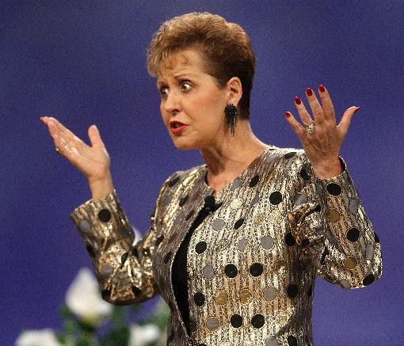
Generally, a positive and uplifting message
Addresses sin as sin
and teaches servant-
hood
Applauded for teach-
ings on women’s
issues
Joyce Meyer
the bondage of Word of Faith
the

Slide 44
Joyce Meyer ~ “He could have helped himself up until the point where he said I commend my spirit into your hands, at that point he couldn’t do nothing for himself anymore. He had become sin, he was no longer the Son of God. He was sin."
the bondage of Word of Faith
the

Slide 45
Joyce Meyer ~ “He became our sacrifice and died on the cross. He did not stay dead. He was in the grave three days. During that time he entered hell, where you and I deserve to go (legally) because of our sin. He paid the price there.”
the bondage of Word of Faith
the

Slide 46
Joyce Meyer ~ “His spirit went to hell because that is where we deserve to go . . . There is no hope of anyone going to heaven unless they believe this truth."
the bondage of Word of Faith
the

Slide 47
Joyce Meyer (on Revelation Knowledge) ~ “The Bible can’t even find any way to explain this. Not really. That is why you have got to get it by revelation. There are no words to explain what I am telling you. I have got to just trust God that he is putting it into your spirit like he put it into mine.”
the bondage of Word of Faith
the

Slide 48
the bondage of Word of Faith
the

Slide 49
Kenneth Copeland ~ “Pray to yourself, because I'm in your self and you're in My self. We are one Spirit, saith the Lord."
the bondage of Word of Faith
the

Slide 50
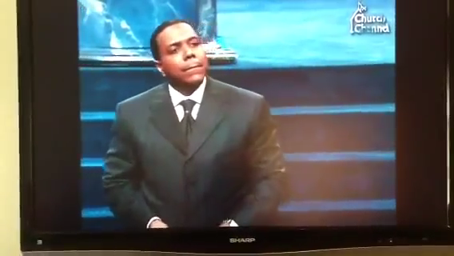
Dog give birth to dogs
Cows give birth to cows
Fish give birth to fishes
Flesh gives birth to flesh
And God gives birth to gods
the bondage of Word of Faith
the

Slide 51
the bondage of Word of Faith
the

Slide 52
Jesus had to be “born again”
“I am not sick”
“I’m ‘believing God’ for a miracle”
“We are ‘little gods’”
“If I just had more faith”
“I trust God that He will do good”
the bondage of Word of Faith
the

Slide 53
the bondage of Word of Faith
the

Slide 54
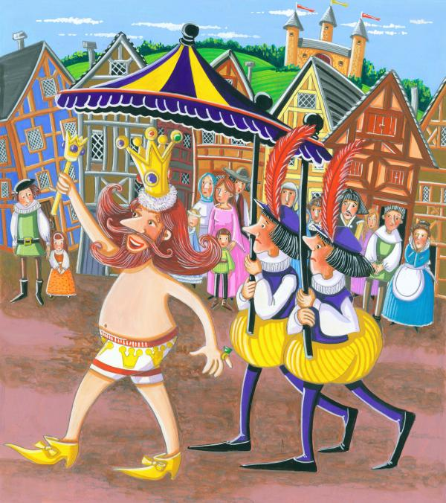
the bondage of Word of Faith
the

Slide 55
the bondage of Word of Faith
the

Slide 56
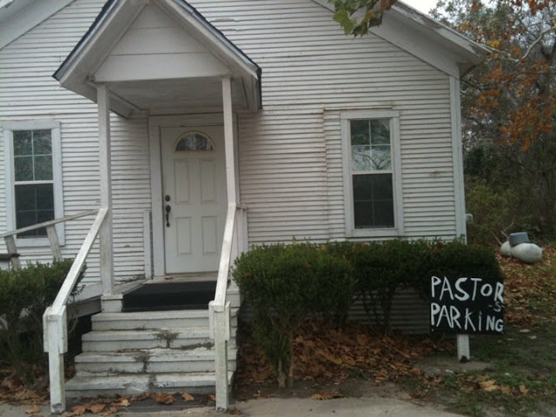
the bondage of Word of Faith
the

Slide 57
the bondage of Word of Faith
the

